Slide 1
BREAST CANCER
BREAST Pathology

Slide 2
Basics
Most common carcinoma in women by incidence
2nd most common cause of cancer mortality
Risk factors mostly related to estrogen exposure

Slide 3
Risk factors
Female gender
Age
Early menarche/ late menopause
Obesity
Atypical hyperplasia
First- degree relative with breast cancer

Slide 4
DCIS
Malignant proliferation of cells in ducts
No invasion of basement membrane
Detected as calcification on mammography
Comedo type has high-grade cells with necrosis and dystrophic calcification in center of ducts

Slide 5
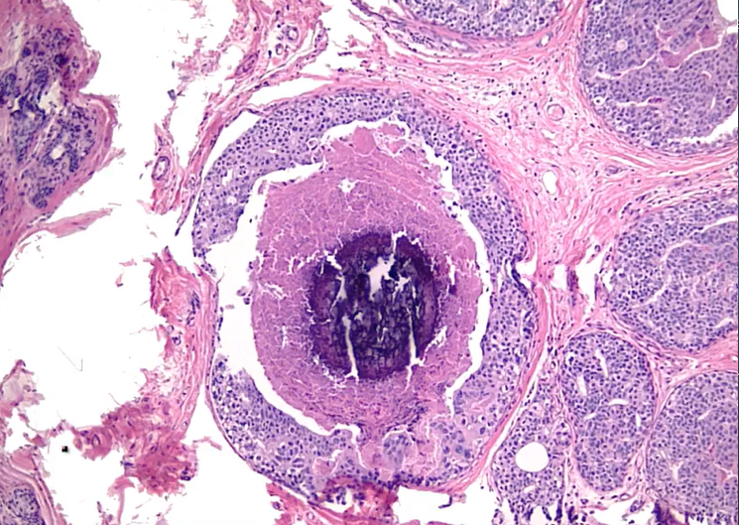

Slide 6
Paget disease
DCIS that extends up ducts to skin of nipple
Presents as nipple ulceration and erythema
Almost always associated with an underlying carcinoma

Slide 7
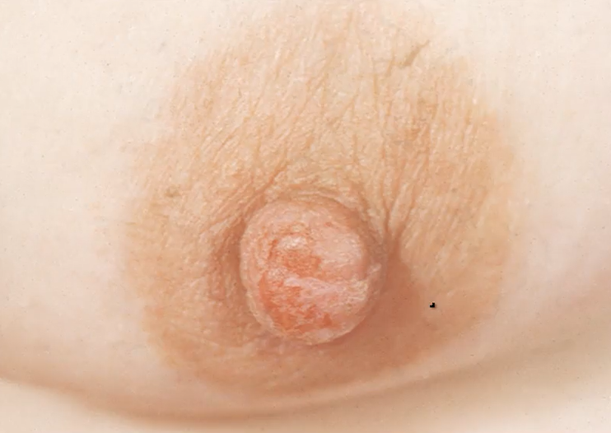

Slide 8
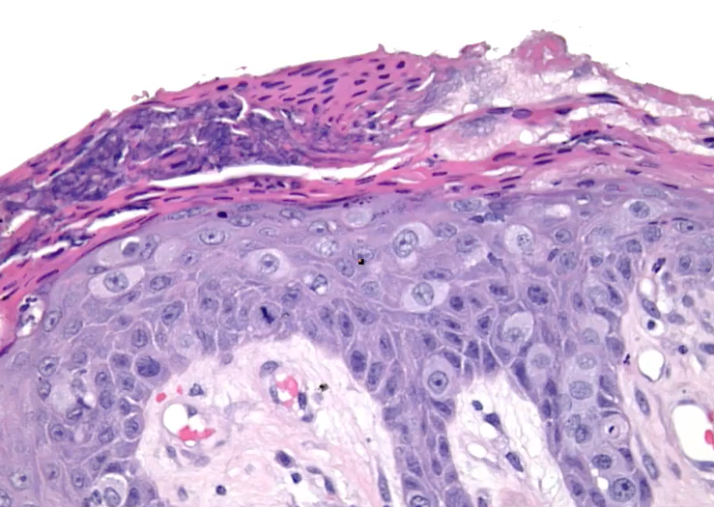

Slide 9
Invasive Ductal Carcinoma
Classically forms duct-like structures
Most common type of invasive carcinoma
Presents as mass detected by physical exam or mammography
Advanced tumors may result in dimpling of skin or retraction of nipple

Slide 10
Biopsy
Duct-like structures in desmoplastic stroma

Slide 11
Special subtypes
Tubular carcinoma
Mucinous carcinoma
Medullary carcinoma
Inflammatory carcinoma

Slide 12
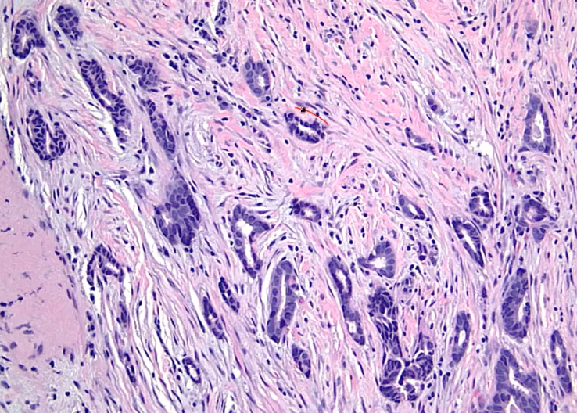

Slide 13
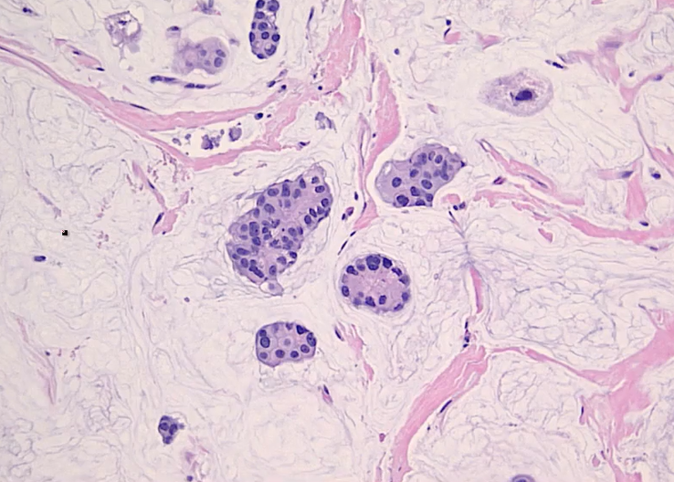

Slide 14
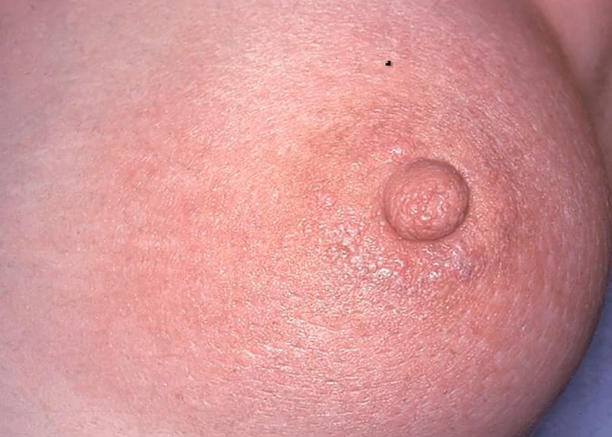

Slide 15
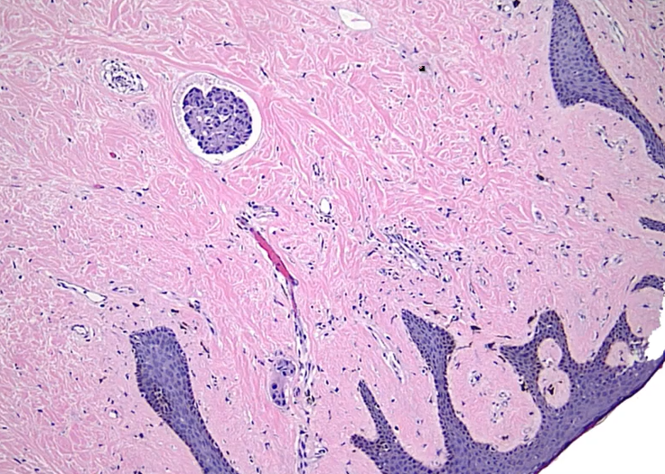

Slide 16
LCIS
Malignant proliferation of cells in lobules
No invasion of basement membrane
Discovered incidentally; does not produce mass or calcification
Dyscohesive cells lacking E-cadherin
Often multifocal and bilateral

Slide 17
Treatment
Tamoxifen and close follow-up
Low risk of progression to invasive carcinoma

Slide 18
Invasive lobular carcinoma
Grows in single-file pattern
No duct formation due to lack of E-cadherin

Slide 19
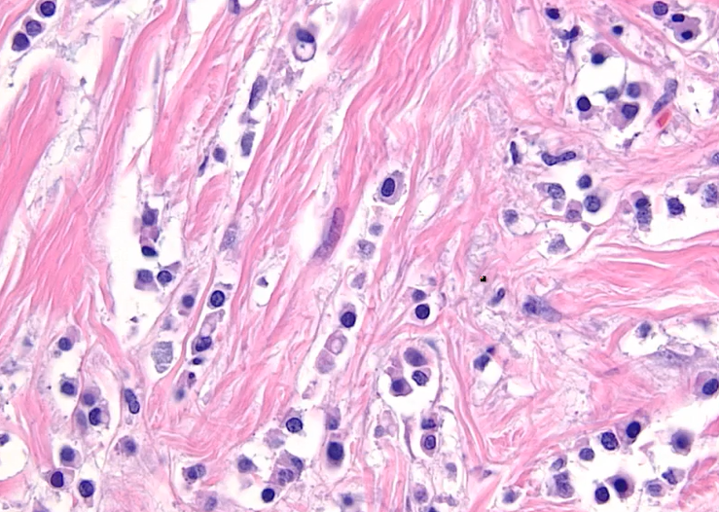

Slide 20
Prognosis based on TNM staging
Metastasis is most important factor
Spread to axillary lymph nodes is most useful factor
Sentinel node biopsy is used to assess axillary lymph nodes

Slide 21
Predictive factors predict response to TX
Most important factors are ER, PR, and HER2/neu gene amplification
ER and PR associated with response to antiestrogenic agents (tamoxifen)
Her2/neu amplification is associated with response to trastuzumab

Slide 22
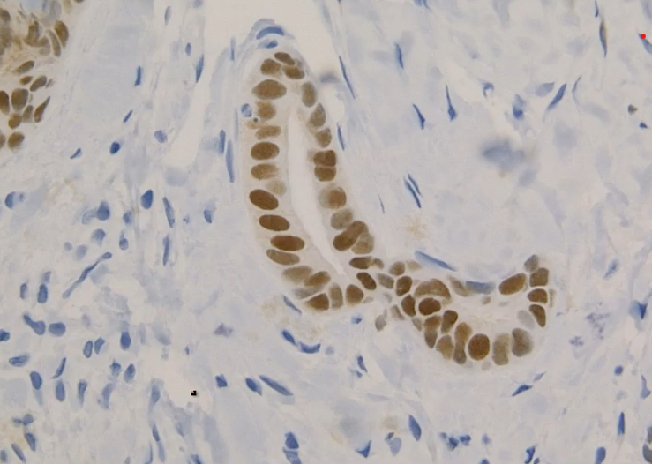

Slide 23
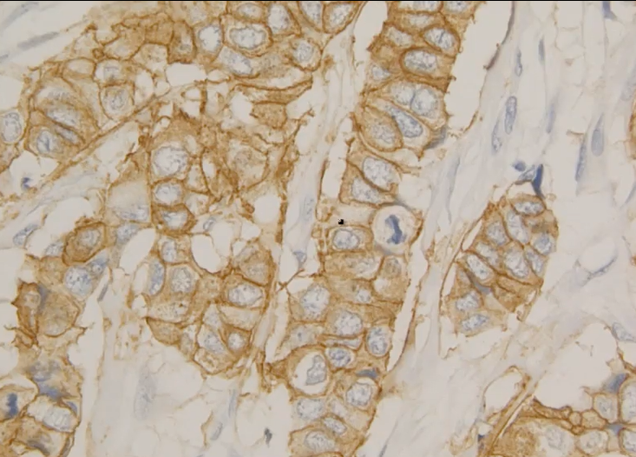

Slide 24
‘Triple-negative’
Negative for ER,PR, and HER2/neu
Poor prognosis
African American women have an increased propensity to develop TN carcinoma

Slide 25
Hereditary breast cancer
Represents 10% of cases of breast cancer

Slide 26
Features suggesting hereditary breast cancer
Multiple-first degree relatives with breast cancer
Tumor at premenopausal age
Multiple tumors

Slide 27
BRCA1 and BRCA2
Most important single gene mutations
BRCA1-breast and ovarian carcinoma
BRCA2- breast carcinoma in males
Women with genetic propensity for breast cancer may choose to undergo prophylactic mastectomy

Slide 28
Male breast cancer
Rare
Subareolar mass under nipple in older males; may produce nipple discharge
Usually invasive ductal carcinoma
Association with BRCA2 mutation and Klinefelter syndrome

